Slide 1
INVESTOR PRESENTATION 2021
Manufactured Housing Properties Inc.
Property pictured herein is owned and managed by
Manufactured Housing Properties.

Slide 2
Disclaimer
The information in this presentation has been prepared by Manufactured Housing Properties Inc. (the “Company”) solely for informational purposes and does not constitute an offer to sell or the solicitation of an offer to purchase securities. Any such offer will be made solely by means of the offering circular contained in a qualified offering statement. The information contained herein may not be used in connection with an offer or solicitation by anyone in any jurisdiction in which such offer or solicitation is not qualified or to any person to whom it is unlawful to make such offer or solicitation. Neither the Securities and Exchange Commission nor any other regulatory body has approved or disapproved or passed upon the accuracy or adequacy of this presentation. The information contained herein remains subject to change. This presentation contains forward-looking statements. Forward-looking statements are typically identified by the use of such terms as “may,” “should,” “could,” “intend,” “plan,” “anticipate,” “estimate,” “believe” or the negative of such terms and other comparable terminology. Such forward-looking statements are based upon the Company’s current plans, expectations, estimates, assumptions and beliefs that involve numerous risks and uncertainties, including, but not limited to, those set forth in the “Risk Factors” section of the offering circular, related to future economic and/or market conditions, as well as future business decisions, which are difficult or impossible to predict accurately or which may be out of the Company’s control. Actual results could vary materially from those set forth in such forward-looking statements. Before investing, a prospective investor should carefully read the offering circular contained in the Company’s offering statement.

Slide 3
Disclaimer (continued)
Important Notice the Regarding Regulation A Offering
An offering statement regarding the offering described above has been filed with the SEC. The SEC has qualified that offering statement, which means that Manufactured Housing Properties Inc. may make sales of the securities described by that offering statement. It does not mean that the SEC has approved, passed upon the merits or passed upon the accuracy or completeness of the information in the offering statement. You may obtain a copy of the offering circular that is part of that offering statement through this link:
https://www.sec.gov/cgi-bin/browse-edgar?action=getcompany&CIK=0001277998
Investing in a public offering like our Regulation A offering is subject to unique risks, tolerance for volatility, and potential loss of your investment, that investors should be aware of prior to making an investment decision. Please carefully review the risk factors contained in the offering circular for this offering.
All company data as of 12/31/20.

Slide 4
OUR MISSION
Providing Affordable Housing
to Residents and Attractive Returns to Investors
Property pictured herein is owned and managed by
Manufactured Housing Properties.

Slide 5
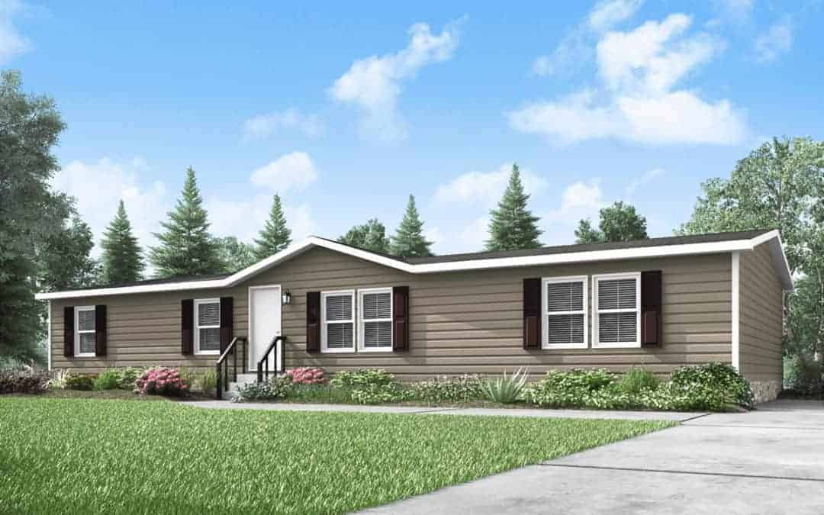

Slide 6
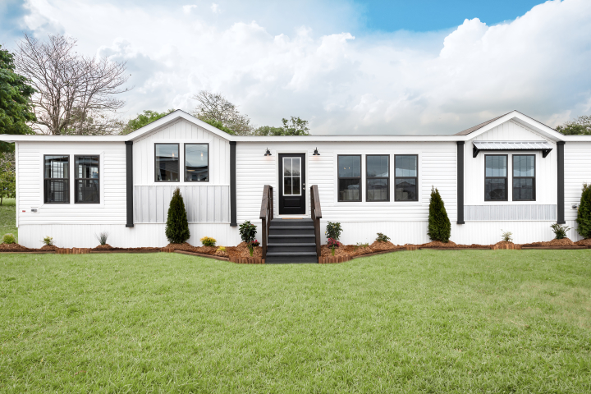

Slide 7
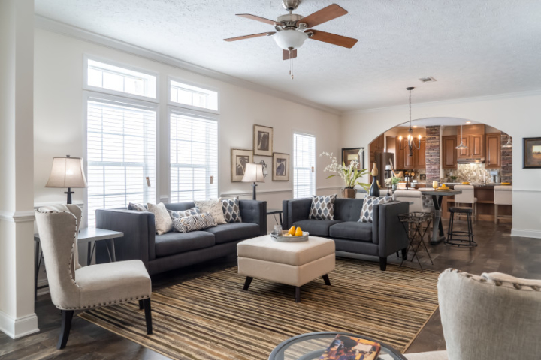

Slide 8
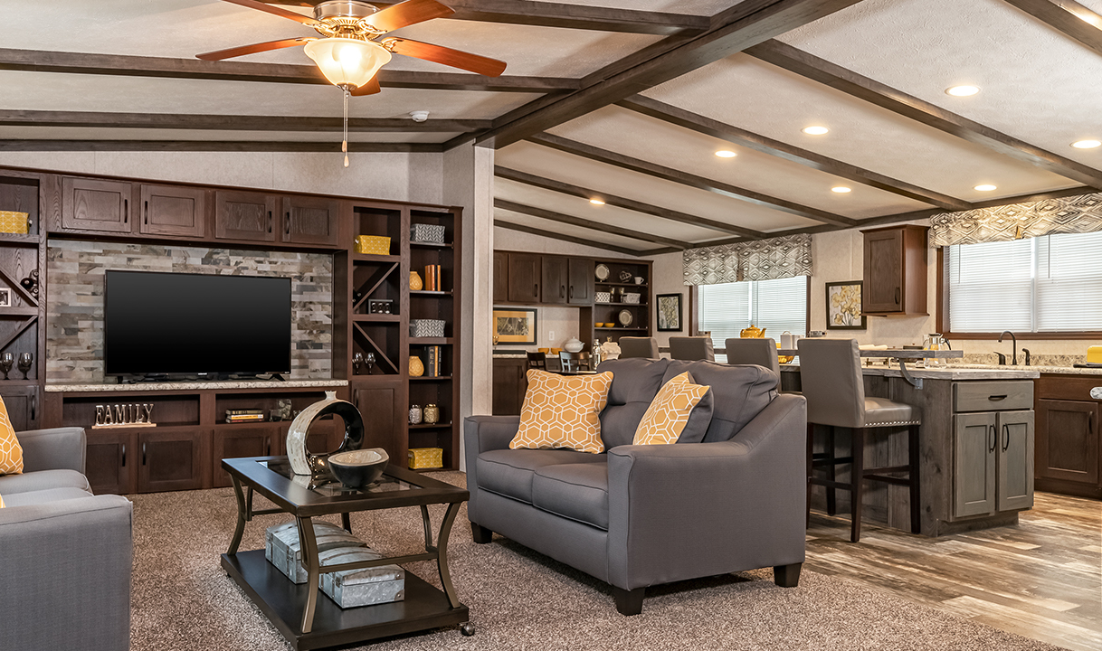

Slide 9
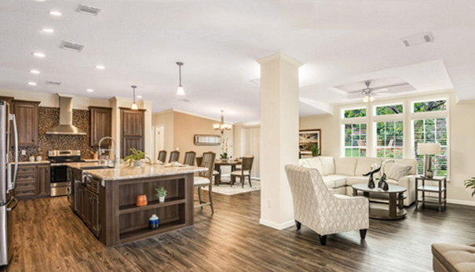

Slide 10
Housing Shortage
THE AFFORDABLE HOUSING PROBLEM¹
Over 30% of all households are “cost-burdened,” spending more than 30% of their income on housing.
1 in 7 households are “severely cost-burdened,” spending more than 50% of their income on housing.
Other challenges for home-buyers include:
Supply shortages
Tighter credit restrictions
Down payment barriers
1. Joint Center for Housing Studies of Harvard University. The State of the Nation’s Housing 2020. https://www.jchs.harvard.edu/sites/default/files/reports/files/Harvard_JCHS_The_State_of_the_Nations_Housing_2020_Report_Revised_120720.pdf

Slide 11
Diminishing Supply
Despite the demand for manufactured housing, supply is diminishing due to:
Redevelopment of current communities
Zoning restrictions
Lack of feasibility for new development
No state in the U.S. has an adequate supply of affordable rental housing for the lowest income renters.⁷
7. National Low Income Housing Coalition. The Gap: A Shortage of Affordable Rental Homes. 2021. https://reports.nlihc.org/gap

Slide 12
The Possible Solution
1
2
Acquire and reposition & therefore preserve existing manufactured housing communities
Develop new manufactured housing communities

Slide 13
Poised for Growth
The dynamics of supply and demand has positioned manufactured housing communities for continued growth.
U.S. AVERAGE NEW
HOME PRICE
Home Price: $347,500³
Manufactured Home Price: $51,371⁴
^{(single wide)}
U.S. AVERAGE
MONTHLY RENT
Apartment: $1,124⁵
Manufactured Home: $549⁶
3. FRED Economic Data. “Median Sales Price of Houses Sold for the United States: Q1 2021.” April 23, 2021. https://fred.stlouisfed.org/series/MSPUS | 4. “How Much Does a New Mobile Home Cost?” September 27, 2019. https://www.moving.com/tips/how-much-does-a-new-mobile-home-cost/ | 5. “Average monthly apartment rent in the United States: February 2021, by apartment size.” https://www.statista.com/statistics/1063502/average-monthly-apartment-rent-usa/ | 6. “Average Monthly Rent for Manufactured Housing in the United States: Q1 2020.” https://www.statista.com/statistics/1038762/mobile-home-monthly-rent-usa/

Slide 14
Manufactured Housing Advantages
Manufactured housing offers many other potential benefits to investors.
Low turnover
Recession resistant
Fewer operating costs
Growing demand
Stable returns

Slide 15
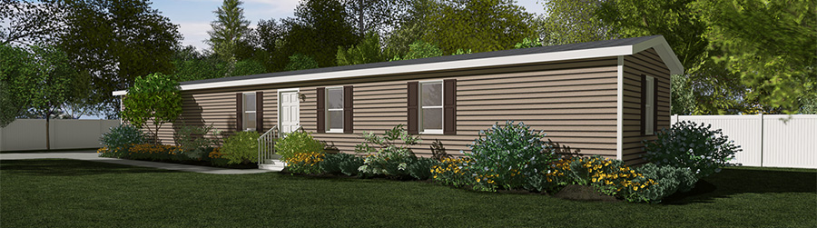
Who is MHPC?
Formed in 2016, Manufactured Housing Properties Inc. (OTC: MHPC) is:
A publicly traded, full-service, vertically integrated owner and operator of manufactured housing communities.
Uniquely positioned to offer a recession resilient, alternative opportunity for our investors.
We believe everyone deserves housing value.
Property pictured herein is owned and managed by Manufactured Housing Properties.

Slide 16
Company Highlights
1
2
Proven and experienced
Cash flow positive
3
4
$50M acquisition pipeline
Generating strong NOI
5
6
Scalable operations
Attractive preferred monthly distributions
7
8
Strong experienced property management team
Geographically well-located in SE where the growth is and will remain

Slide 17
Our Objectives
MHPC strives to:
Acquire, reposition and manage communities in markets with favorable employment and population characteristics.
Provide attractive risk-adjusted returns for our investors, with a focus on value creation, capital preservation and growth.

Slide 18
Our Strategy (continued)
MHPC targets properties that are:
1
2
3
Located in
favorable metro areas
Underperforming
Under-capitalized
4
5
Requiring tenant
repositioning
Undervalued

Slide 19
Our Portfolio
MHPC targets areas with favorable employment statistics, demographic characteristics and affordable housing needs across the high-growth southeastern U.S.
30 communities
1,532 home sites
96% average portfolio occupancy
124% increased revenue growth over last year
$375 average lot rent
$400 average lot rent
4 locations in North Carolina, South Carolina, Georgia and Tennessee

Slide 20
Southeast Concentration
MHPC focuses on the high-growth regions of the southeastern United States.
CURRENT PORTFOLIO VALUE
2021 Projected NOI $5,700,000
Portfolio Capitalization Rate 5.5%
Portfolio Market Value $104,000,000
CURRENT PORTFOLIO CAPITAL STRUCTURE
Senior Debt $33,000,000
Equity $71,000,000
Portfolio Market Value $104,000,000

Slide 21
The Offering
SERIES C CUMULATIVE REDEEMABLE PREFERRED STOCK
Offering Size | $47 million
Dividends | 7% current annual return paid in monthly preferred distributions
Term | 60 months
Principal Repayment | 1.1x repayment of initial capital at the end of the term
Minimum Investment | $10,000
Example | $100,000 investment, $7,000 annual return paid monthly ($583.33/mo.) and a payment of $110,000 at the end of five years
Offering Price | $1,000 Preferred Unit

Slide 22
The Offering (continued)
SERIES C CUMULATIVE REDEEMABLE PREFERRED STOCK
Investment Structure | Reg. A
Preferred Return | 7%
Capital | 1.1x
Tax Reporting | 1099
Early Redemptions* | Available quarterly at shareholder request. Year 1 – 11% redemption fee Year 2 – 8% redemption fee Year 3 – 5% redemption fee Year 4+ - no redemption fee No redemption fee for death or disability *Please refer to our offering circular for details regarding limitations and restrictions on redemptions.

Slide 23

Our Strategy (continued)
MHPC is led by a committed and aligned management
and operations team with more than 40 years of combined experience in manufactured housing management and
70 years in real estate and public company experience.
Responsible for the MHPC’s long-term strategy
Current CEO of Gvest Capital LLC, a real estate investment company
Former head of structured products for Royal & Sun Alliance
Former head of the Latin American real estate practice for Arthur Andersen in Mexico City
BBA in Finance, the University of Oklahoma
Raymond M. Gee
CEO

Slide 24

Our Team
Responsible for finance and accounting, day-to-day corporate & portfolio management, and SEC reporting
Former executive of several public and private companies across many sectors
Over 25 years of experience in accounting and financial management
Broad public company experience with SEC, regulatory, and mergers and acquisitions expertise
Master’s in Finance, Florida Atlantic University
Michael Z. Anise
President

Slide 25

Our Team
Responsible for identification and execution of MHPC’s investment strategies
Over 25 years of experience in commercial real estate investment, finance and development
Former Principal of Pinnacle Capital Partners, a real estate investment and development company
Experience working with Deutsche Bank Mortgage Capital, Royal & Sun Alliance, Gvest Capital LLC
Master’s in Land Economics & Real Estate, Texas A&M University
Adam A. Martin
CIO

Slide 26
Thank You
Thank you for your time today.
For more information, please visit
www.MHProperties.com or call (980) 273-1702.
Securities offered through Arete Wealth Management, LLC,
member FINRA, SIPC and NFA.
Arete Wealth Management, LLC and
Manufactured Housing Properties Inc. are not affiliated.

